Slide 1

Onion Architecture: Untangle the Application Core
Fedor Shchudlo
SOFTWARE DEVELOPER
@fshchudlo github.com/fshchudlo
Headshot optional

Slide 2

UI, API
Application Core
Responsibilities of each layer?
Where to place validation?
How does it play with DDD?
Should I always have all these layers?
Dependencies goes inwards
Domain Model
Domain Services
Tests
App Services
DB
Infrastructure
External Service

Slide 3
Discuss the business use case to implement
Sample implementation
Responsibilities of Application Core’s layers
Is this complexity required in any case?
Overview

Slide 4
Electrical equipment store
Company website
Customer
Order
Warehouse
Management
System
Customer
Supplier
Order

Slide 5

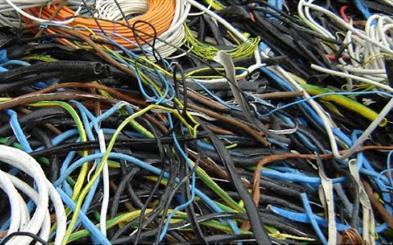
Cable ordering rules
Reservation rules

Slide 6
Ordering System Web API
Not a real world application

Slide 7
Can it be simpler in some cases?
Simple Domain
No integrations
Single Bounded Context
One-time code

Slide 8
Onion Architecture is good for complex systems
Separates Application Core to three layers
Domain Model
Domain Services
Application Services
Dependencies goes inwards
Able to work without Infrastructure and UI
Follow YAGNI and KISS principles
Summary

